Slide 1
Kuehne + Nagel
Internships

Slide 2
About Kuehne+Nagel
> 78,000
Professionals delivering excellence to customers every day
400,000
customers trust us to manage their logistics
1,395
offices worldwide, so that we are close to our customers
109
countries, connected by our network
No.1
sea freight worldwide
No.1
air freight worldwide
No.4
Road logistics in
Europe
No.2
contract logistics
All figures relate to 2021

Slide 3

Tallinn IT Centre 550+ specialists

Slide 4



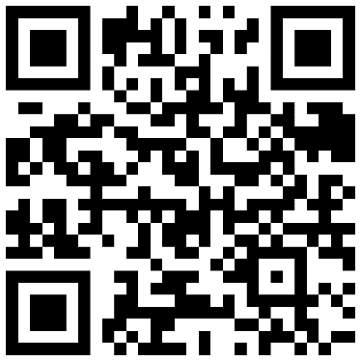
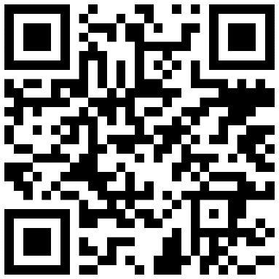
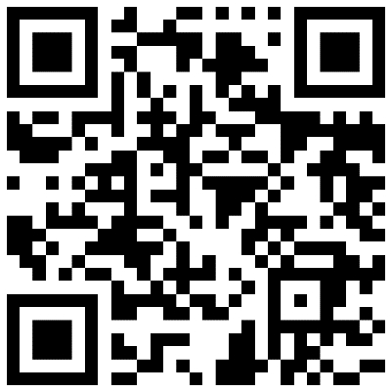
Internships offered in Tallinn
Full stack Developer
Devops Engineer
IT Support Engineer

Slide 5

Your Journey into Professional IT

Slide 6
Time availability
Students
Workers
Ready to work
Notes:
Main title font: Arial bold 24pt Dark blue Box title font: Arial 24pt bold black + white
Box description font: Arial 14pt black + white

Slide 7

Inspire

Slide 8

Enpower

Slide 9

Deliver

Slide 10










Internship Programs 2022
Enpower
Deliver
Inspire
Basic
Frameworks
Team Stack
Variable
10+ hours
Full time
Not compensated
Not compensated
Compensated

Slide 11






Internship Programs 2022
Enpower
Deliver
Inspire
Trainings
Younicorn
Elite
Live remote learning sessions. Catalog of learning resources
One trainee One research project
Team of trainees. Work on KN product prototype.
Open source
Guild
Workforce
Hybrid team employees/trainees Supply chain product prototype
Team of trainees Product prototype
Join KN team in their working routines on production project.

Slide 12

When to apply?
March Spring Internships
October Winter Internships
Deadline 15th March
Java React Fullstack DevOps engineer
It Support
June Summer Internships
Notes:
Main title font: Arial bold 24pt KN dark blue
Timeline details font: Arial 12pt black
Change the icons: You may swap the icons for ones you prefer in Frontify

Slide 13
How to apply?
https://jobs.kuehne-nagel.com/global/en
Want to know more?
kn.it.school@kuehne-nagel.com

